Slide 1

Arduino and Relay
Connecting to a Fan

Slide 2
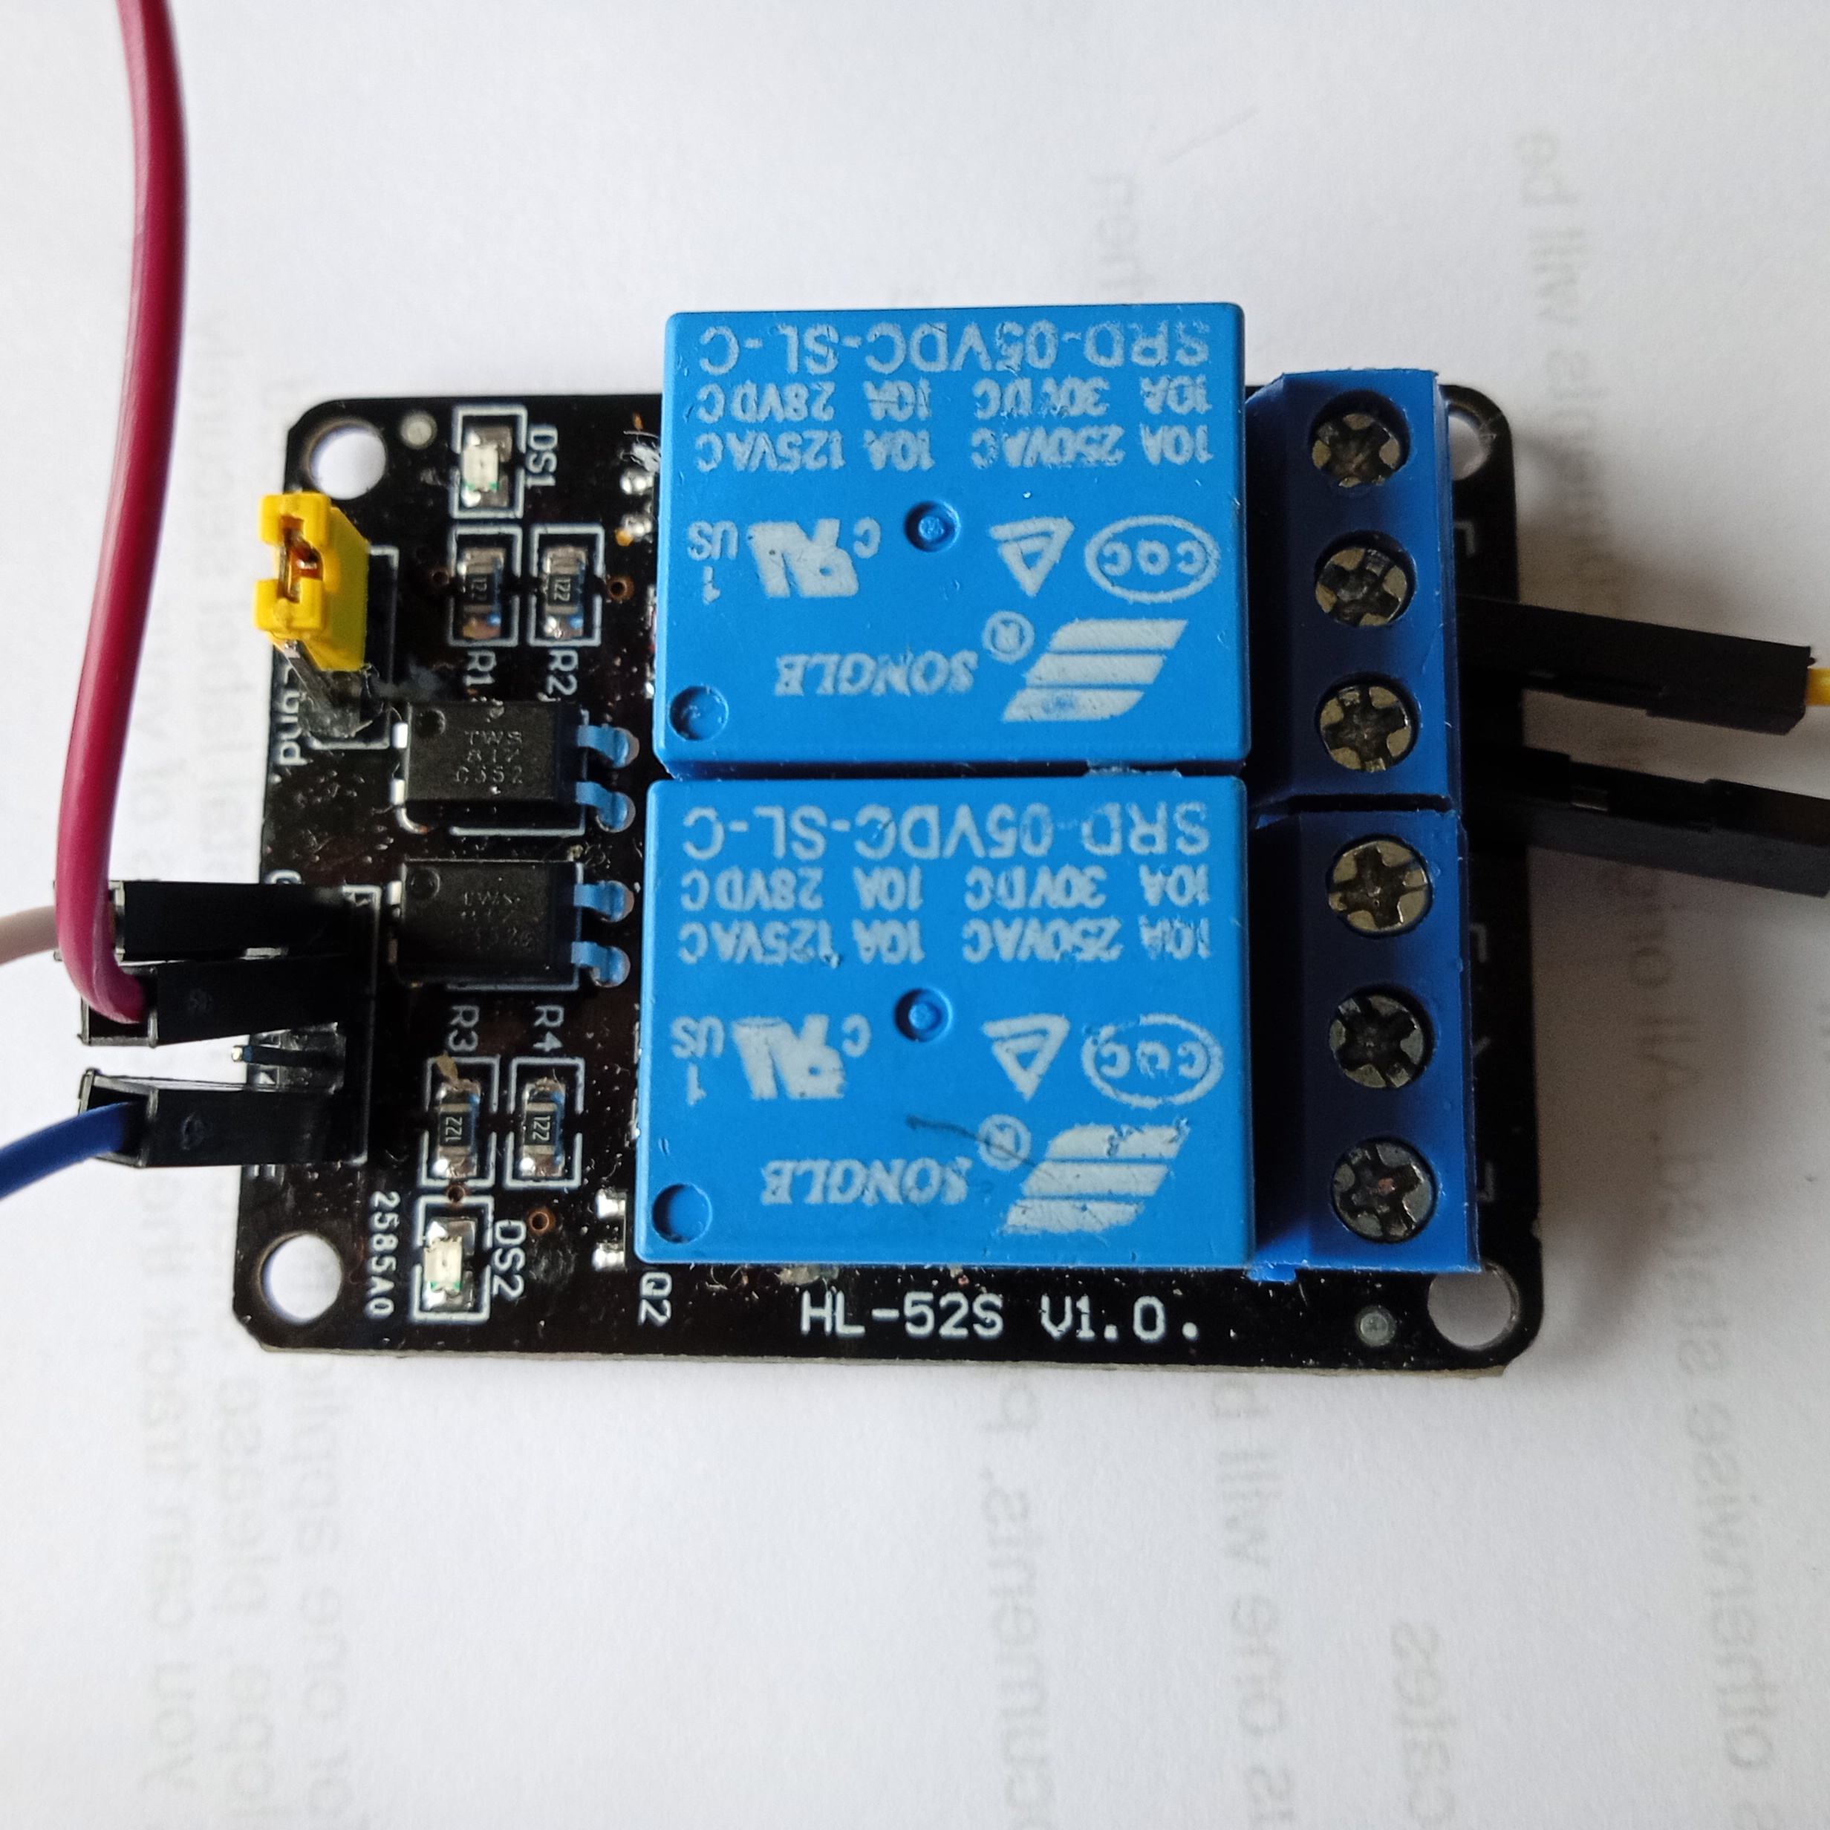
Wiring the Relay
NC – COM – NO | NC – COM – NO
Positive of battery to COM of relay
Positive of fan to NO (normally Open)
Ground to ground of arduino
IN1 (Reay 1) To pin 7 of arduino
VCC To 5V of arduino

Slide 3
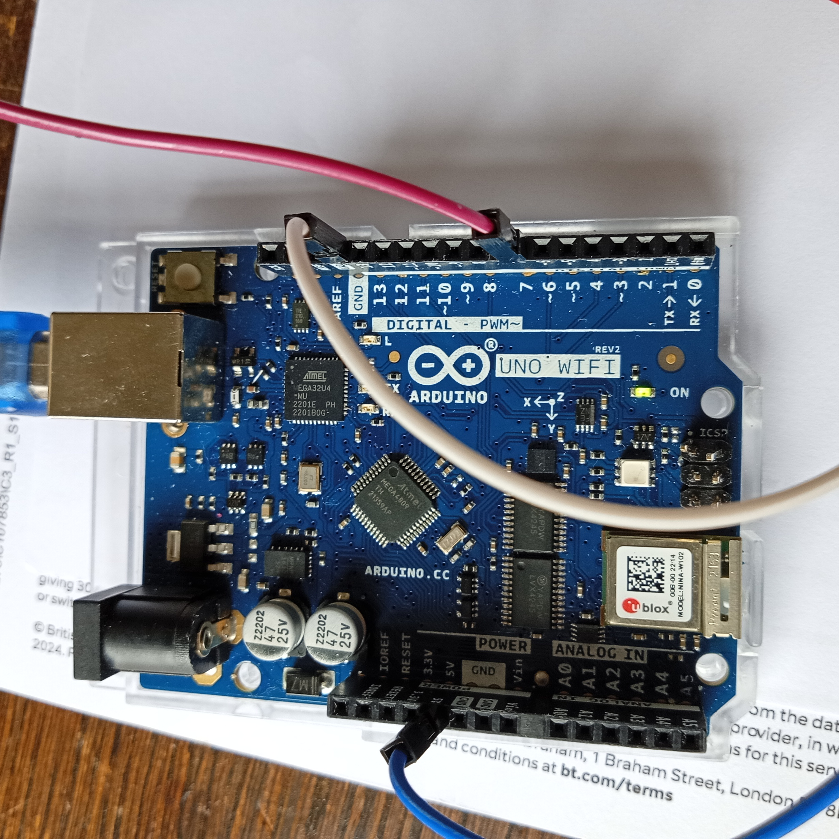
Wiring the Arduino
Pin 7 to IN1 of Relay
5V to VCC of Relay
Grounds to Ground of Relay

Slide 4
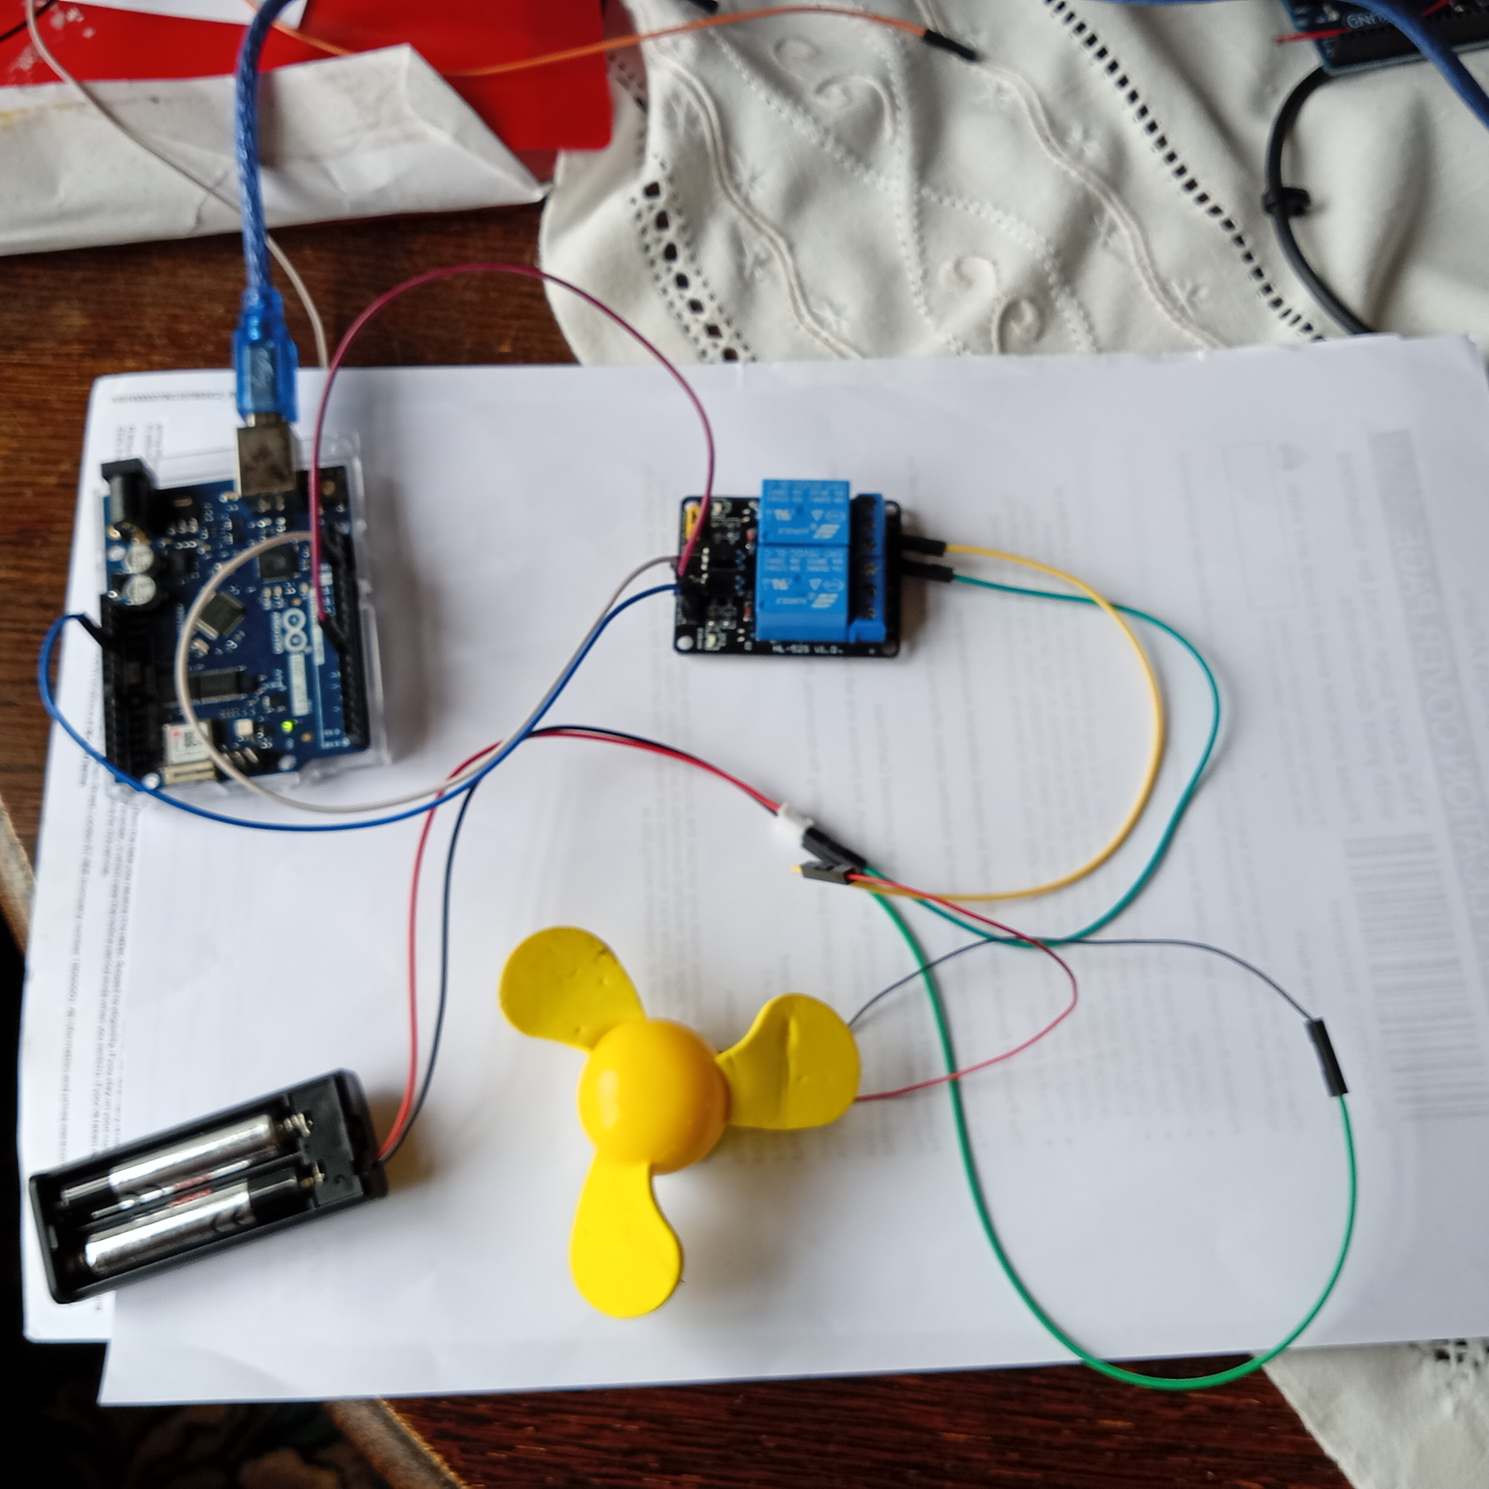
All together
Negative of fan to negative of battery
Positive of fan to NO of relay
Positive of battery to COM of relay
Negative of battery to negative of fan

Slide 5
Arduino Basic Sketch
// Pin connected to relay IN1
const int RELAY1 = 7;
void setup() {
pinMode(RELAY1, OUTPUT);
digitalWrite(RELAY1, HIGH); // Relay OFF at start (active LOW)
}
void loop() {
// Turn relay ON (motor runs)
digitalWrite(RELAY1, LOW);
delay(3000); // motor runs for 3 seconds
// Turn relay OFF (motor stops)
digitalWrite(RELAY1, HIGH);
delay(3000); // motor rests for 3 seconds
}

Slide 6
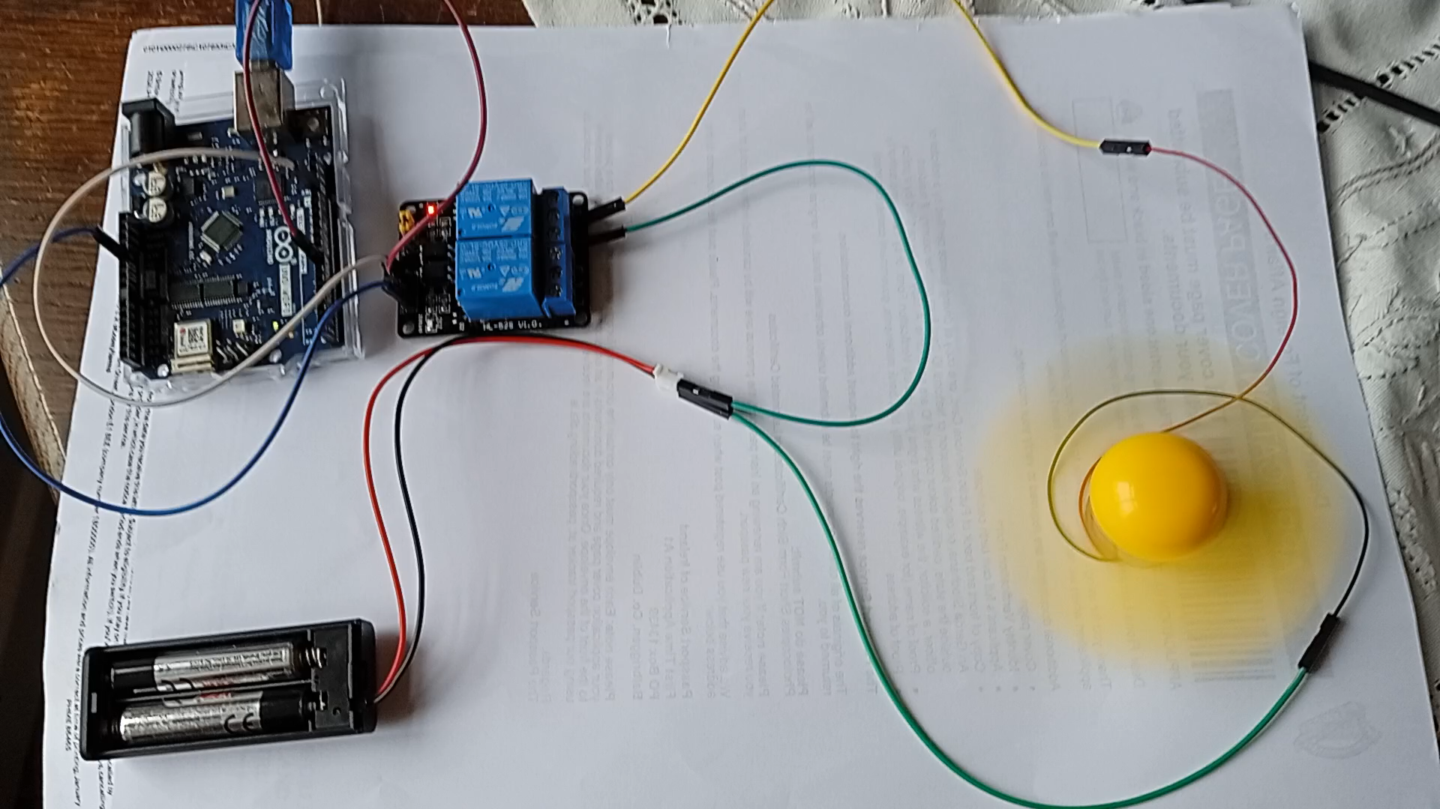
Video of Circuit

